Slide 1

Object-Oriented Software Analysis & Design (COMP-3220) Lecture 0 Overview
School of Computer Science
Faculty of Science
University of Windsor
Dr. Saeed Samet

Slide 2
Overview
Object-Oriented Programming (Java Focused)
UML
Object-Oriented Design Patterns
GRASP

Slide 3
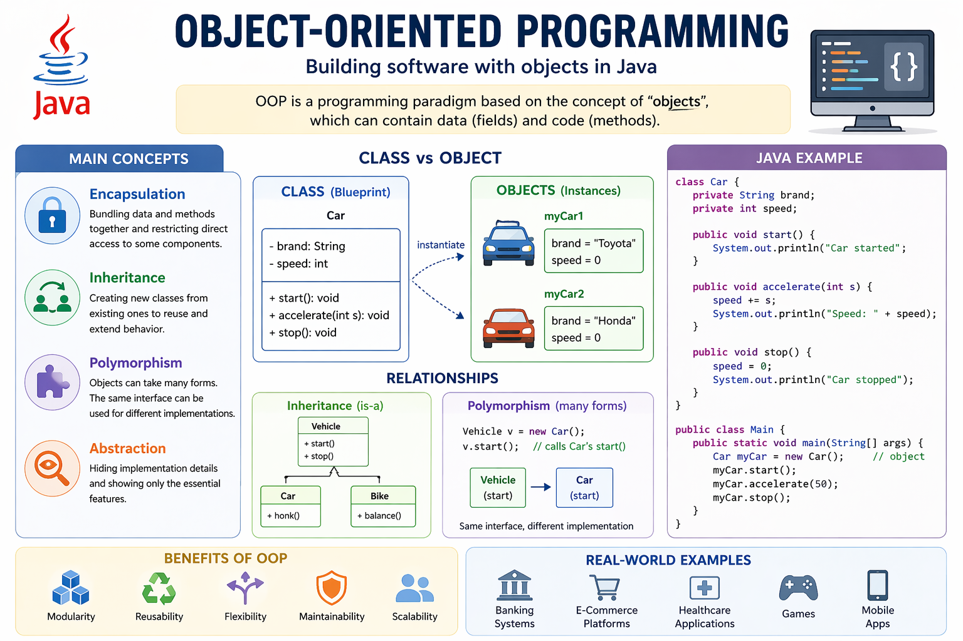

Slide 4
What is Object-Oriented Programming (OOP)?
Definition
A programming paradigm that models software as a collection of objects that encapsulate state (data) and behavior (methods).
Core idea
Organize programs around objects interacting with each other, rather than procedures operating on data.
In Java
Everything revolves around classes and objects
Strongly typed, class-based language
Supports encapsulation, inheritance, and polymorphism natively

Slide 5
Classes and Objects (Java Perspective)
Class
Blueprint for creating objects
Defines fields (attributes) and methods (behavior)
Object
Instance of a class
Has its own state and behavior
Example (Java)
class Car {
String model;
void drive() {
System.out.println("Driving...");
}
}
Car c = new Car(); // object creation
c.drive();

Slide 6
Encapsulation
Concept
Bundling data and methods together, and restricting direct access to some components.
Why it matters
Protects object integrity
Enables controlled access via methods
Java mechanisms
Access modifiers: private, protected, public
Getters and setters
Example
class Account {
private double balance;
public void deposit(double amount) {
balance += amount;
}
}

Slide 7
Inheritance
Concept
Creating new classes based on existing ones to reuse and extend behavior.
Why it matters
Promotes code reuse
Establishes “is-a” relationships
Java keyword
extends
Example
class Vehicle {
void move() { }
}
class Car extends Vehicle {
void honk() { }

Slide 8
Polymorphism
Concept
Objects can take many forms, allowing the same interface to be used for different implementations.
Types in Java
Compile-time: method overloading
Run-time: method overriding (dynamic dispatch)
Example
Vehicle v = new Car();
v.move(); // calls Car’s version if overridden

Slide 9
Abstraction
Concept
Hiding implementation details and exposing only essential features.
Why it matters
Reduces complexity
Focuses on what an object does, not how
Java mechanisms
abstract classes
interface
Example
interface Shape {
double area();
}

Slide 10
Key OO Principles in Practice
Modularity
divide system into manageable components
Reusability
reuse classes via inheritance/composition
Extensibility
add new behavior with minimal changes
Maintainability
easier debugging and evolution

Slide 11
Composition vs Inheritance
Composition (has-a)
Build complex behavior by combining objects
More flexible, preferred in many designs
Inheritance (is-a)
Reuse via hierarchy
Can lead to tight coupling if overused
Rule of thumb: Favor composition over inheritance

Slide 12
Java-Specific OO Features
Interfaces with default methods (since Java 8)
Packages for modular organization
Garbage collection (automatic memory management)
Strong typing and compile-time checks
Exception handling integrated into method design

Slide 13
Big Picture
OOP helps manage complexity through abstraction and modularity
Java enforces OO structure, making it ideal for learning OO design
Mastering OOP is foundational before moving to design patterns
OOP provides the building blocks; design patterns provide the refinements.

Slide 14
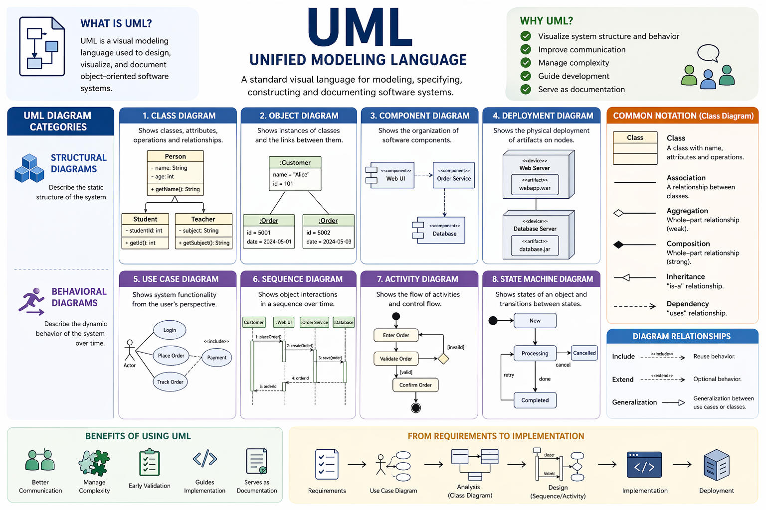

Slide 15
What is UML?
Unified Modeling Language (UML)
A standardized visual language for modeling, specifying, and documenting software systems.
Purpose
Provide a common notation for developers, designers, and stakeholders
Visualize system structure and behavior before and during implementation
Bridge the gap between requirements → design → code
Key idea
UML is a modeling language, not a programming language.

Slide 16
Why Use UML?
Benefits
Improves communication within the team
Helps manage system complexity through abstraction
Supports design reasoning and early validation
Serves as documentation for maintenance and evolution
When it’s useful
Designing system architecture
Explaining designs in lectures or meetings
Reverse-engineering existing codebases

Slide 17
Main Categories of UML Diagrams
Structural Diagrams (Static View)
Describe the structure of the system
Class Diagram (most important in OO design)
Object Diagram
Component Diagram
Deployment Diagram
Behavioral Diagrams (Dynamic View)
Describe how the system behaves over time
Use Case Diagram
Sequence Diagram
Activity Diagram
State Machine Diagram

Slide 18
Class Diagram (Core for OO Design)
Represents
Classes, attributes, methods
Relationships between classes
Key relationships
Association (uses/knows)
Aggregation / Composition (has-a)
Inheritance (is-a)
Dependency (temporary use)
Example (conceptual)
Car ──has──> Engine
Car ──is-a──> Vehicle
Class diagrams are the backbone of OO design modeling

Slide 19
Sequence Diagram (Interactions)
Focus
Object interactions over time
Key elements
Lifelines (objects)
Messages (method calls)
Time flows top → bottom
Use case
Understanding runtime behavior
Designing collaborations between objects

Slide 20
Use Case Diagram (User Perspective)
Focus
System functionality from the user’s point of view
Elements
Actors (users or external systems)
Use cases (functionalities)
Relationships (include, extend)
Purpose
Capture functional requirements
Define system scope at a high level

Slide 21
UML and Java (Mapping)
Class Diagram → Java Code
Class → class
Attributes → fields
Methods → functions
Inheritance → extends
Interface realization → implements
Example mapping
UML: Car ──|> Vehicle
Java: class Car extends Vehicle

Slide 22
Best Practices
Keep diagrams simple and focused
Use UML to clarify design, not to over-document
Combine multiple diagrams for different perspectives
Update diagrams as design evolves

Slide 23
Big Picture
UML helps visualize both structure and behavior
Essential for OO analysis and design
Complements code by providing a higher-level view
Good UML models don’t replace code—they help you write better code.

Slide 24
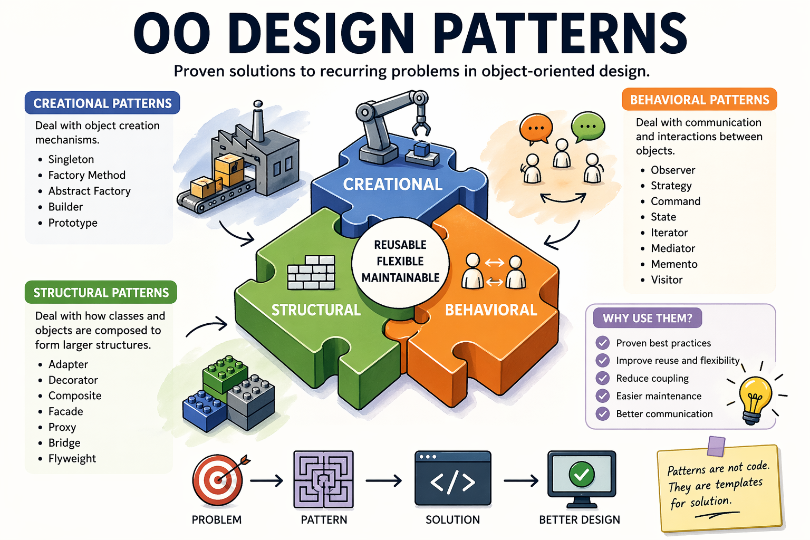

Slide 25
Why Design Patterns Matter
What are Design Patterns?
Reusable, proven solutions to recurring design problems in object-oriented systems.
Why they are important
Provide a shared vocabulary (e.g., “Factory”, “Observer”) for communicating design ideas
Promote best practices and reduce reinventing solutions
Improve maintainability and scalability of software systems
Capture expert knowledge and design trade-offs
Key idea
Patterns are not code templates—they are design abstractions that guide structure and collaboration.

Slide 26
Motivation for Using Design Patterns
Common challenges in OO design
Tight coupling between classes
Code duplication and poor reuse
Difficulty adapting to change
Complex object creation or interaction logic
How patterns help
Encourage loose coupling and high cohesion
Support flexibility and extensibility
Encapsulate what varies in a system
Provide clear separation of concerns
Example intuition
Instead of hardcoding object creation → use Factory
Instead of polling for changes → use Observer

Slide 27
Categories of Design Patterns
Design patterns are typically grouped into three main categories:
Creational Patterns
Purpose: Object creation mechanisms
Goal: Decouple what is created from how it is created
Examples: Singleton, Factory Method, Abstract Factory, Builder, Prototype
Structural Patterns
Purpose: Class and object composition
Goal: Build flexible and efficient structures
Examples: Adapter, Decorator, Composite, Facade, Proxy
Behavioral Patterns
Purpose: Object interaction and responsibility distribution
Goal: Manage communication and behavior among objects
Examples: Observer, Strategy, Command, State, Iterator

Slide 28
Big Picture
Design patterns help transition
basic OOP → robust software design
They encode design principles (e.g., Open/Closed Principle, Dependency Inversion)
Choosing the right pattern is about understanding trade-offs, not memorization
Good design is not about using many patterns—it is about using the right pattern when needed.

Slide 29
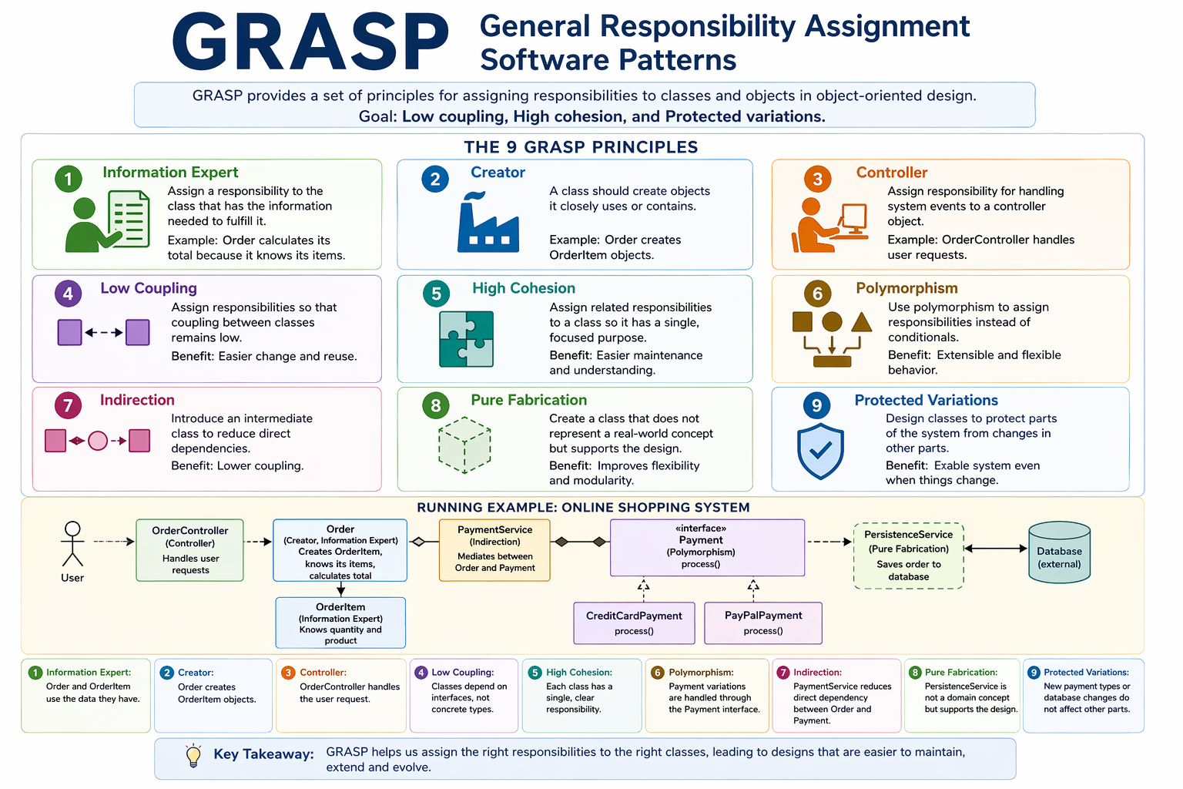

Slide 30
What is GRASP?
GRASP (General Responsibility Assignment Software Patterns)
A set of principles for assigning responsibilities in OO design.
Introduced by Craig Larman
Focus: who should do what?
Goal: maintainable, flexible, and understandable systems

Slide 31
Why GRASP?
Without clear responsibility assignment:
Classes become overloaded (low cohesion)
Systems become rigid (high coupling)
Changes ripple across code
GRASP helps you:
Make better design decisions
Reduce complexity
Improve extensibility

Slide 32
The 9 GRASP Principles
Information Expert
Creator
Controller
Low Coupling
High Cohesion
Polymorphism
Indirection
Pure Fabrication
Protected Variations

Slide 33
Information Expert
Assign responsibility to the class with the data.
✔ Order calculates total
❌ UI or external class does it

Slide 34
Creator
A class creates objects it closely uses.
✔ Order creates OrderItem
✔ OrderItem references Product

Slide 35
Controller
Handle system events outside UI.
✔ OrderController.placeOrder()
❌ UI directly managing business logic

Slide 36
Low Coupling & High Cohesion
Low Coupling
Minimize dependencies between classes
High Cohesion
Keep classes focused and simple
✔ Small, focused classes
✔ Easier maintenance

Slide 37
Polymorphism
Replace conditionals with dynamic behavior.
❌ if (paymentType == “CreditCard”) …
✔ payment.process()

Slide 38
Indirection & Pure Fabrication
Indirection
Add an intermediate class to reduce dependency
Pure Fabrication
Create artificial classes for better design
✔ PaymentService
✔ PersistenceService

Slide 39
Protected Variations
Encapsulate parts likely to change.
✔ Use interfaces / abstractions
✔ Isolate external systems

Slide 40
Running Example: Online Shopping System
Scenario
User places an order with multiple items and selects a payment method.
Step 1: Controller
OrderController
Receives placeOrder() request
Coordinates workflow
Step 2: Creator
Order
Creates OrderItem objects
Order → creates → OrderItem

Slide 41
Running Example: Online Shopping System
Step 3: Information Expert
Order
Knows its items
Computes total price
OrderItem
Knows quantity and product
Step 4: Polymorphism
Define:
interface Payment {
process();
}
Implementations:
CreditCardPayment
PayPalPayment
No if-else needed.

Slide 42
Running Example: Online Shopping System
Step 5: Low Coupling
Order does NOT depend on specific payment types
Depends on Payment interface
Step 6: High Cohesion
Order → manages order logic
Payment → handles payment
Controller → handles flow
Each class has one clear role.
Step 7: Indirection
Introduce:
PaymentService
Mediates between Order and Payment

Slide 43
Running Example: Online Shopping System
Step 8: Pure Fabrication
PersistenceService
Saves orders to database
Not a domain concept, but improves design
Step 9: Protected Variations
Payment methods may change
Database may change
Solution:
Use interfaces (Payment, Repository)
Isolate changes

Slide 44
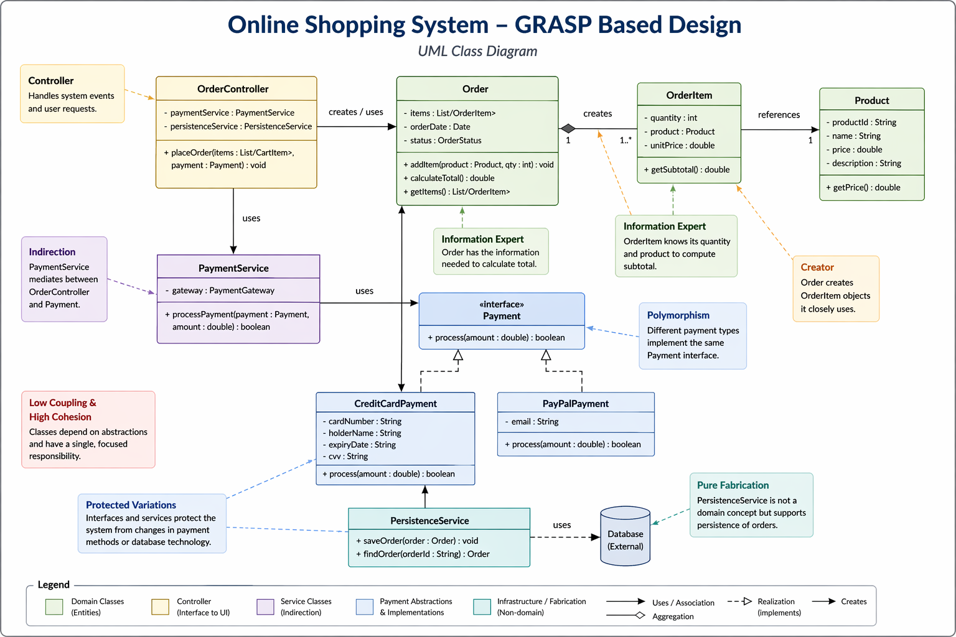

Slide 45
Final Design Summary
Controller manages flow
Domain objects handle their own data
Interfaces protect variability
Services reduce coupling
Key Takeaway
GRASP is not about what to build. It is about how to assign responsibilities correctly.
→ Better design decisions lead to better software

